Slide 1






OS Project
Library Management System
Presented by: Alishba Waqar (46997)

Slide 2


Agenda
Introduction
Project Architecture
Features
System Flow (Bash Script)
Data Storage & File Handling
Future Enhancements
Conclusion

Slide 3


Introduction
•Library Management System Using Linux Shell Scripting
•Objective: Automate library operations and efficiently manage book records and user details.
•Scope: Simplified library tasks such as adding, issuing, and returning books.

Slide 4


Project Architecture
1
2
3
Input Module, which collects user and admin commands via the terminal
Processing Module, which handles tasks like searching, issuing, and returning books
Output Module, which displays results such as operation statuses and error messages.

Slide 5





Features
Admin Side
Student Side
Add, remove, or view book records.
View borrowed book logs.
Borrow and return books.
Search for books by title/author
View available books.
Borrow and return books.
Track borrowing history.
Delete Registration
Register
Student can register for login

Slide 6
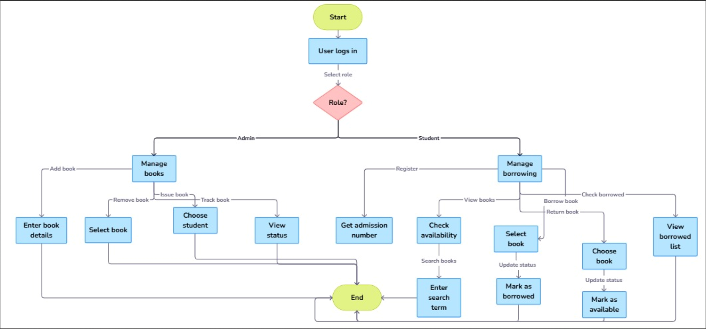
System Flow (Bash Script)

Slide 7


Data Storage & File Handling
File Formats:
Books File: Stores book details (BookID, Title, Author, Status).
User File: Stores user credentials and data.
Log File: Maintains borrowing/return history.
Implementation:
Data stored in plain text files.
Tools used: grep, awk, sed for file operations.

Slide 8





Future Enhancements
Add a GUI layer for better user experience.
Implement advanced search filters.
Enable email notifications for due dates.

Slide 9

Conclusion
In conclusion, this project showcases the power of Linux shell scripting in automating library management tasks, simplifying book and user data handling, and providing an efficient solution for real-world challenges.

Slide 10

Thank You

